Slide 1
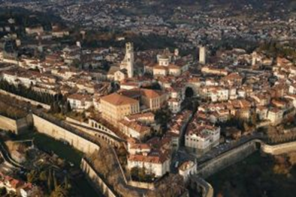
31° Conference of ENTIS 7-9 May 2020
BERGAMO
Poison Control Center and Teratology Information Service
CENTRO CONGRESSI “GIOVANNI XXIII”
WITH THE PATRONAGE OF
ITALIAN SOCIETY
OF TOXICOLOGY
ITALIAN SOCIETY
OF PSYCHIATRY
ITALIAN SOCIETY
OF NEONATOLOGY
www.asst-pg23.it

Slide 2
Thursday, May 7 Chair: Board
08.00 – 12.00 Board, Scientific Committee and Website Committee Meetings
Lunch on your own
11.30 – 12.30 Registration
12.30 – 15.30 ENTIS business meeting
15.30 – 16.00 Coffee Break
SESSION 1 TRAINING IN TERATOLOGY Chair: Orna Diav-Citrin
16.00 – 16.45 Basics in teratology teaching G. Koren
16.45 – 17.30 Drug-induced malformations and effects due to genetic causes: areas of overlapping and differential diagnosis. M. Clementi
17.30 – 18.15 Challenges in prenatal diagnosis and fetal therapy. S. Običan
18.15 – 19.00 Post graduate teaching: experiences, challenges C. Chambers
FREE EVENING
Friday, May 8
SESSION 2 PREGNANCY: RARE SITUATIONS Chair: Marco De Santis & Corinna Weber-Schoendorfer
09.00 – 09.10 Welcome Greetings
09.10 – 09.30 Prosthesis in pregnancy A. Giampreti
09.30 – 09.50 Pharmacological treatment of opiate addiction in pregnant women L. Somaini
09.50 – 10.20 Substances of abuse in pregnancy: possible consequences on neonatal brain development
G. Biggio
10.20 – 10.40 Antipsychotics in pregnancy: balancing between risks of untreated illness and risks of drug- related adverse effects U. Albert
10.40 – 11.10 Long-Acting Injectable Antipsychotics use in pregnancy. The Papa Giovanni XXIII Hospital experience E. Bondi, C. Palumbo
11.10 – 12.10 Coffee Break and Poster visit
SESSION 3 PREGNANCY: RARE SITUATIONS Chair: Yusuf Cem Kaplan & Per Damkier
12.10 – 12.30 Disease activity assessment of rheumatic diseases and treatment during pregnancy
S. Breda, V. Ramoni
12.30 – 12.50 Reprotoxic effects of drugs and chemicals: differences and similarities between clinical and regulatory approaches R. Butera
12.50 – 13.10 Discussion
13.10 – 14.00 Lunch
FREE COMMUNICATIONS Chair: Herbert Juch & Lucie Hubičková Heringová
14.00 – 14.15 Free communications 1
14.15 – 14.30 Free communications 2
14.30 – 14.45 Free communications 3
14.45 – 15.00 Free communications 4
15.00 – 15.15 Free communications 5
15.15 – 15.30 Free communications 6
15.30 – 16.30 Coffee Break and Poster visit
SESSION 4 PREGNANCY: RARE SITUATIONS Chair: Matteo Cassina & Thierry Vial
16.30 – 16.50 Epilepsy in pregnancy: the HPG23 Hospital experience S. Pirola
16.50 – 17.10 Analgesic treatment in late pregnancy and the risk of Ductus Arteriosus Restriction L. Patanè
FRIDAY NIGHT: ENTIS DINNER
www.asst-pg23.it

Slide 3
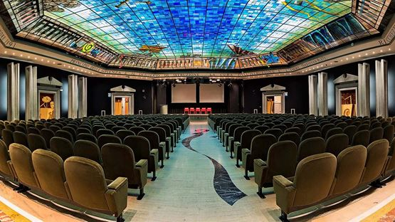
Saturday, May 9
SESSION 5 NEONATAL ABSTINENCE SYNDROME - BREASTFEEDING ASPECTS
Chair: Matitiahu Berkovitch & Stephanie Padberg
09.00 – 09.20 Regulatory aspects on pharmacotherapy during breastfeeding: Italian overview L. Tartaglia
09.20 – 09.40 The behaviour of health professionals when advising on the use of drugs during breastfeeding: ethical considerations A. Clavenna
09.40 – 10.00 Drugs of abuse in breastfeeding: the old and new psychoactive substances M. Gallo
10.00 – 10.20 Neonatal Abstinence Syndrome: laboratory findings M. Molinaro
10.20 – 10.40 The pharmacokinetics of antidepressant drugs in breastfeeding D. Cattaneo
10.40 – 11.00 Controversies in breastfeeding R. Davanzo
11.00 – 11.20 Discussion
11.20 – 12.00 Coffee Break and Poster visit
SESSION 6 FREE COMMUNICATIONS AND DEBATES Chair: Ursula Winterfeld & Bernke te Winkel
12.00 – 12.10 Free communications 7
12.10 – 12.20 Free communications 8
12.20 – 12.30 Free communications 9
12.40 – 12.40 Free communications 10
12:40 – 13.30 Ultra-actual debates: Topics will be available on the congress website in due course
14:00 CLOSURE
www.asst-pg23.it

Slide 4
SPEAKERS
Albert Umberto, University of Trieste
Biggio Giovanni, University of Cagliari
Bondi Emi, HPG23, Bergamo
Breda Silvia, HPG23, Bergamo
Butera Raffaella, Toxicon, Pavia
Cattaneo Dario, Hospital Sacco, Milan
Chambers Christina, OTIS, USA
Clavenna Antonio, Mario Negri, Milan
Clementi Maurizio, University of Padua
Davanzo Riccardo, Hospital Burlo, Trieste
Elefheriou Georgios, HPG23, Bergamo
Gallo Mariapina, HPG23, Bergamo
Giampreti Andrea, HPG23, Bergamo
Koren Gideon, University of Jerusalem
Molinaro Maria Delfina, San Matteo, Pavia
Običan Sarah, OTIS, USA
Palumbo Claudia, HPG23, Bergamo
Patanè Luisa, HPG23, Bergamo
Pirola Serena, HPG23, Bergamo
Ramoni Veronique, San Matteo, Pavia
Somaini Lorenzo, SERD, Biella
Tartaglia Loriana, ISS, Rome
CONFERENCE LOCATION
Centro Congressi Giovanni XXIII
Viale Papa Giovanni XXIII, 106
24121 Bergamo
REGISTRATION FOR THE CONGRESS
On-line registration will be available
on the congress website in due course.
ACCOMMODATION
Information on hotel room reservation and booking will be available on the congress website in due course.
POSTERS
Information on poster format will be available on the ENTIS website in due course.
DEADLINE DATES
Abstract submission opens 15 November 2019
Abstract deadline 31 January 2020
Notification of acceptance to authors 15 February 2020
ABSTRACTS
Information on abstract submission will be available on the ENTIS website in due course.
Registration at special rates
1 February -15 March 2020 (280.60 euro)
Registration at normal rates
16 March - 30 April 2020 (329.40 euro)
Registration on congress site
7-9 May 2020 (390.40 euro)
One day Registration
1 February - 9 May 2020 (150 euro)
ENTIS DINNER
Included for registered participants
Accompanying persons and one day registration (61.50 euro)
THURSDAY AND SATURDAY LUNCH
By your own
CONTACT
Centro Congressi Giovanni XXIII
Tel. +39 035 236435
Fax +39 035 236474
e-mail. info@congresscenter.bg.it
Acknowledgment for Reprotox and Elsevier sponsorship of abstracts
www.asst-pg23.it

